Slide 1
Lecture 7: Conditional Statements
CSC111: Introduction to CS through Programming
R. Jordan Crouser
Assistant Professor of Computer Science
Smith College

Slide 2
Announcements
A note about getting credit for labs:
Turn in what you have before you leave the lab
Both partners must submit (your submissions can be identical)
If you want, you may revise/resubmit for up to 3 days (not required)
A note about the homework:
Make sure that you follow the formatting instructions exactly
Enter first number
Enter second number
Enter operation
The answer is: <ANS>
Failure to do so will result in a delay in grading your assignment

Slide 3
Overview of the week
More about variables
Numeric values and basic operations
More mathematical operators
Revisiting ints and floats
The math module
Formatting
Lab: Cash Machine
Conditional (“if”) statements

Slide 4

RECAP
How is information represented
using electricity?

Slide 5
One wire: a “bit”
“off”
“on”
Notes:
Let’s simplify things way down. Imagine our computer has just a single wire in it. If we’re going to try to represent information by running electricity through this wire, we’ve got two possible states: off and on. That’s not a whole lot to work with, but it’s enough to represent False and True, 0 and 1, No and Yes… or any other pair of values. Because we can represent exactly two things, this is called a “binary” system. The on/off state of a single wire is called a ”bit”, and it’s the smallest piece of information a computer can store.

Slide 6
So how does a hard drive work?

Slide 7
RECAP: how does a hard drive work?

Slide 8
RECAP: how does a hard drive work?

Slide 9
RECAP: how does a hard drive work?

Slide 10
Bits and booleans
Bits: 0 and 1
Boolean values: True and False
Boolean switches: imagine a world where every decision has a binary choice:
Go out or stay in?
Walk or take the car?
Batman or Spiderman?
George Boole
1815 - 1864

Slide 11
So far: linear programs

Slide 12
What if we need to make a choice?

Slide 13
Booleans to the rescue!

Slide 14
Booleans to the rescue!

Slide 15
Just one problem: how do we write it?

Slide 16
We can only type one line at a time...

Slide 17
What we want to say

Slide 18
What we have to work with

Slide 19
Real life examples (pseudocode)
if (today is a weekday):
go to class
else: # (today is a weekend)
sleep in
if (food at Tyler looks good):
eat at Tyler
else: # food at Tyler doesn’t look good
order Domino’s

Slide 20
Real life example (our change machine)
Amount? 71
3 $20-bill(s)
1 $10-bill(s)
0 $5-bill(s)
1 $1-bill(s)
print the ”s”
only if necessary

Slide 21
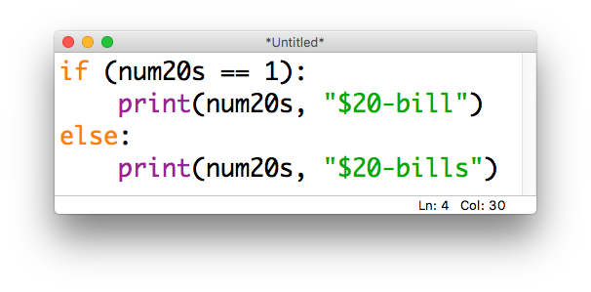
Real life example (our change machine)

Slide 22
Relational operators
Operator | Meaning
== | equal to
!= | not equal to
< | less than
<= | less than or equal to
> | greater than
>= | greater than or equal to
these come in handy when constructing
boolean statements

Slide 23
Discussion: multiple conditions
if (it is sunny):
go to the beach
if (it is snowy):
go skiing
else:
stay home

Slide 25
Sequential if statements are independent
if (it is sunny):
go to the beach
if (it is snowy):
go skiing
else:
stay home

Slide 26
The else refers only to the nearest if
if (it is sunny):
go to the beach
if (it is snowy):
go skiing
else:
stay home

Slide 27
To chain multiple “checks” together: elif
if (it is sunny):
go to the beach
elif (it is snowy):
go skiing
else: # it is neither sunny nor snowy
stay home
evaluated in order

Slide 28
To chain multiple “checks” together: elif
if (it is sunny):
go to the beach
elif (it is snowy):
go skiing
else: # it is neither sunny nor snowy
stay home
evaluated in order

Slide 29
Remember: order matters!
if (it is sunny): # regardless of snow
go to the beach
elif (it is snowy): # but not sunny
go skiing
else: # it is neither sunny nor snowy
stay home
evaluated in order

Slide 30
Remember: order matters!
if (it is snowy): # regardless of sun
go skiing
elif (it is sunny): # but not snowy
go to the beach
else: # it is neither sunny nor snowy
stay home
evaluated in order

Slide 31
Nested conditions
if (class is cancelled):
if (you have homework):
work on homework
else: # class cancelled, no HW binge-watch Netflix

Slide 32
Simultaneous conditions
if (it’s Friday and it’s 4pm):
go to tea
if (you’re hungry or you’re bored):
go to the CC

Slide 33
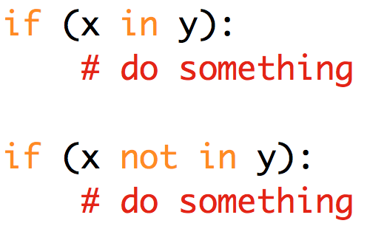
Boolean statements about sets

Slide 34
Notes:
Counts toward CS major

Slide 35
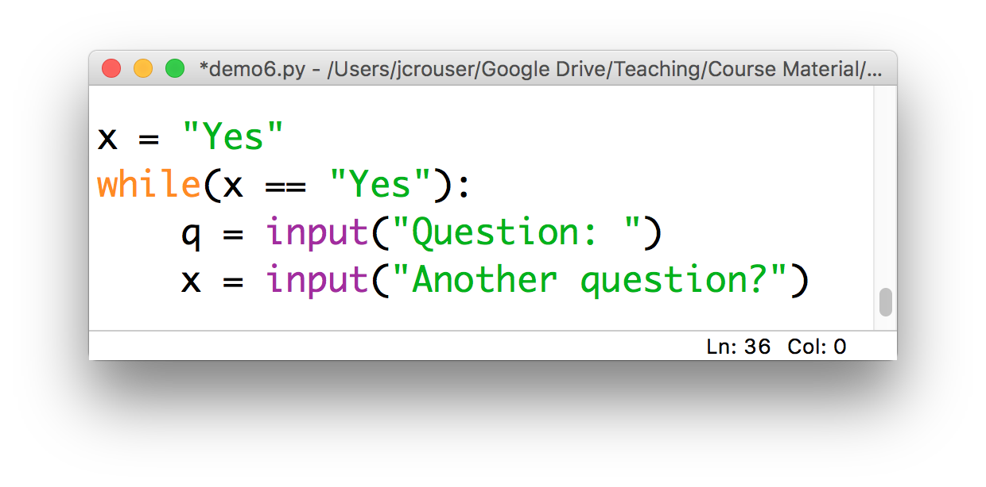
Side note: while() loops
Boolean statements will also come in handy for controlling a new kind of loop, e.g.

Slide 36
Overview of the week
More about variables
Numeric values and basic operations
More mathematical operators
Revisiting ints and floats
The math module
Formatting
Lab: Cash Machine
Conditional (“if”) statements

Slide 37
Coming up next
A2: Clunky Calculator is due Sunday 11:55pm
Mon 9/24: strings and string methods
Weds 9/26: the main() method
Lab: Pretty Printing
Fri 9/28: Life skill #2: Debugging

